Slide 1

EDUCATIONAL QUIZ FOR
SPECIAL CHILDREN
NAME: DILANI R
REG.NO: 8115U23EC023
DEPARTMENT: ECE
SUBJECT: PYTHON PROGRAMMING

Slide 2
CONTENT
INTRODUCTION
IMPORTANCE OF ENGAGING SPECIAL CHILDREN
TECHNOLOGY USED
WORK FLOW
PROS AND CONS
CONCLUSION

Slide 3


INTRODUCTION
Educational Quiz is designed especially for special children.
This quiz is tailored to engage and empower children with unique abilities, ensuring that learning is both fun and accessible.
Provides an inclusive learning experience and covers a
variety of topics in an accessible format, with adaptive
features to support diverse learning styles.

Slide 4
Importance of Engaging Special Children
Personalized Learning The quiz adapts to each child's pace and abilities, ensuring an engaging and empowering experience. Boosting Confidence Successful completion of the quiz helps build self-esteem and a sense of achievement in special children. Inclusive Education The quiz promotes inclusivity and celebrates the diverse talents and capabilities of all learners. Skill Development The quiz incorporates essential skills such as problem-solving, memory, and critical thinking.

Slide 5
TECHNOLOGY USED
Datetime Module
The datetime module supplies classes for manipulating dates and times.In this program, it is used to record the start and end times of the quiz and to calculate the duration of the quiz.
String Methods
lower() is used to perform case-insensitive comparison of user answers.
format() (through f-strings) is used to format strings, making output more readable and informative.
list and tuple
They are used to store the quiz questions and answers. They are used to organize the data in a structured way.
Dict
It is used to store the quiz questions and answers in a dictionary format. This allows for easy access to the questions and answers based on their keys.

Slide 6
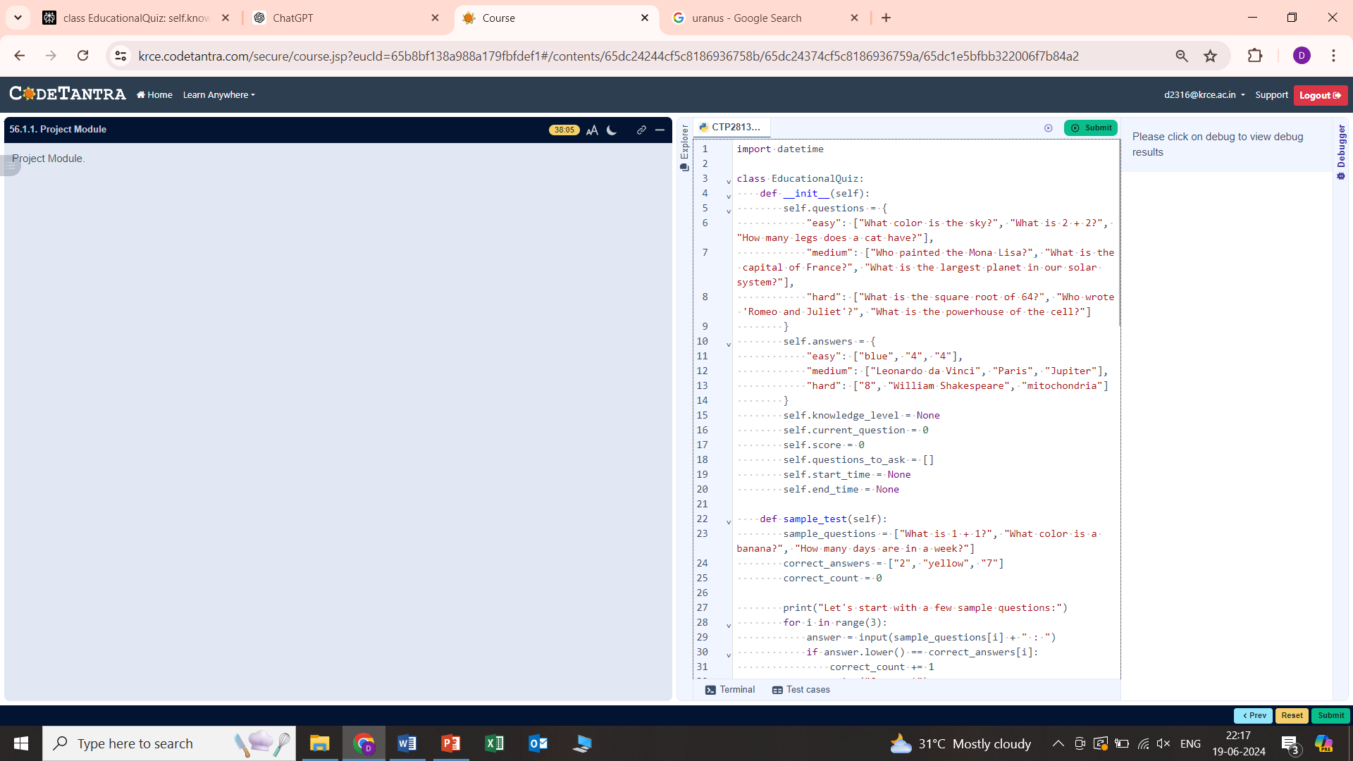
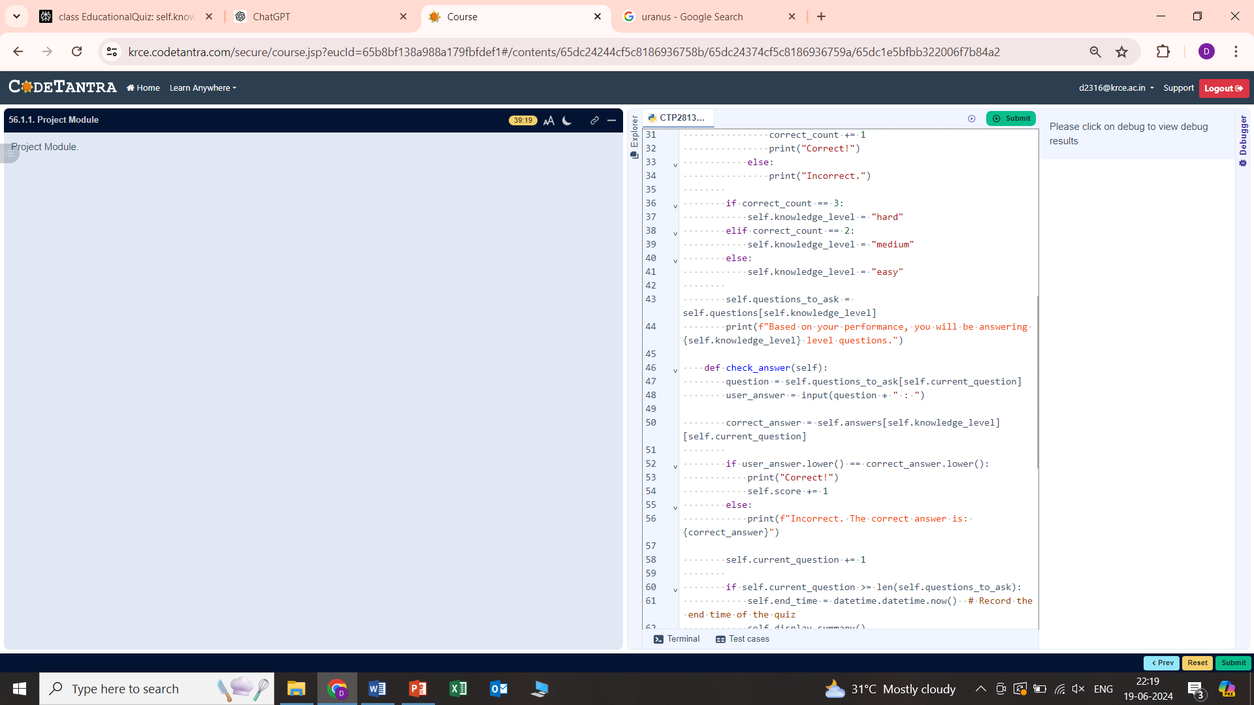
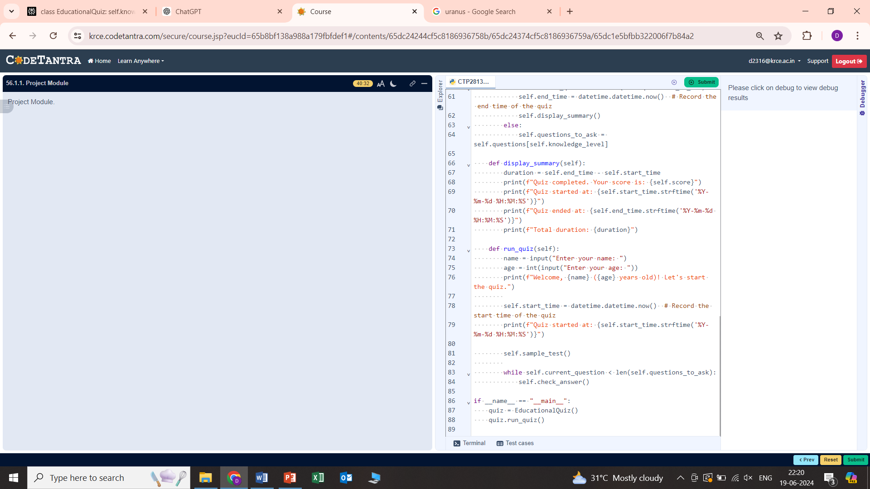
PROGRAM

Slide 7
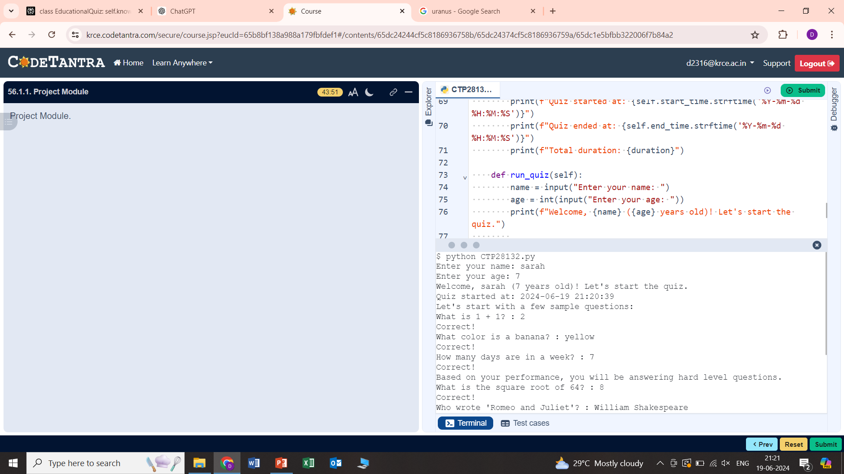
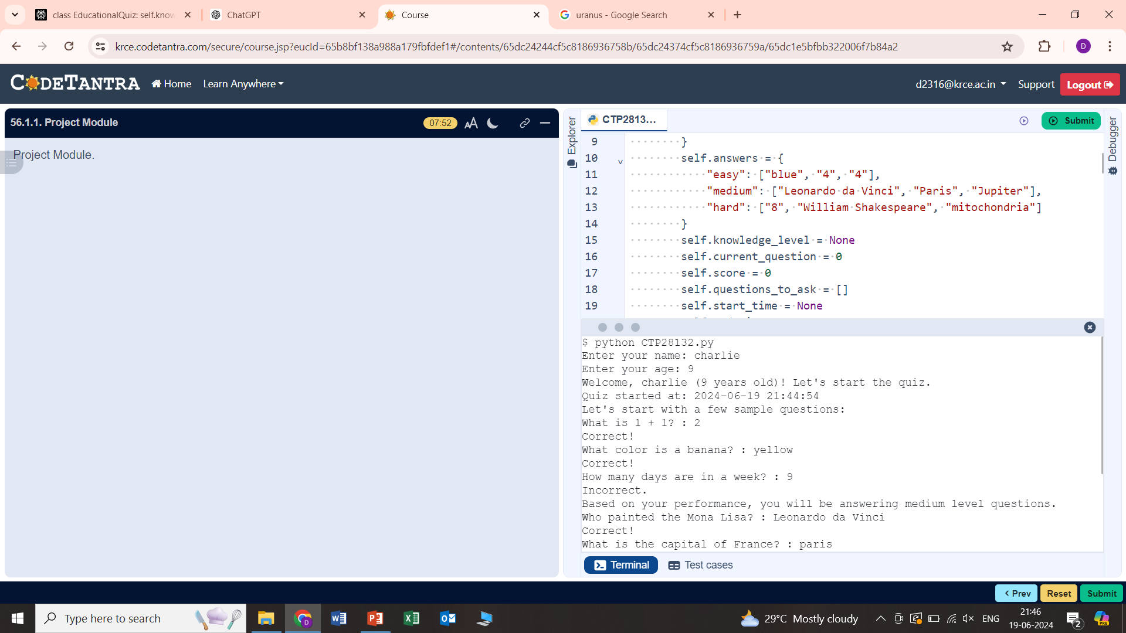
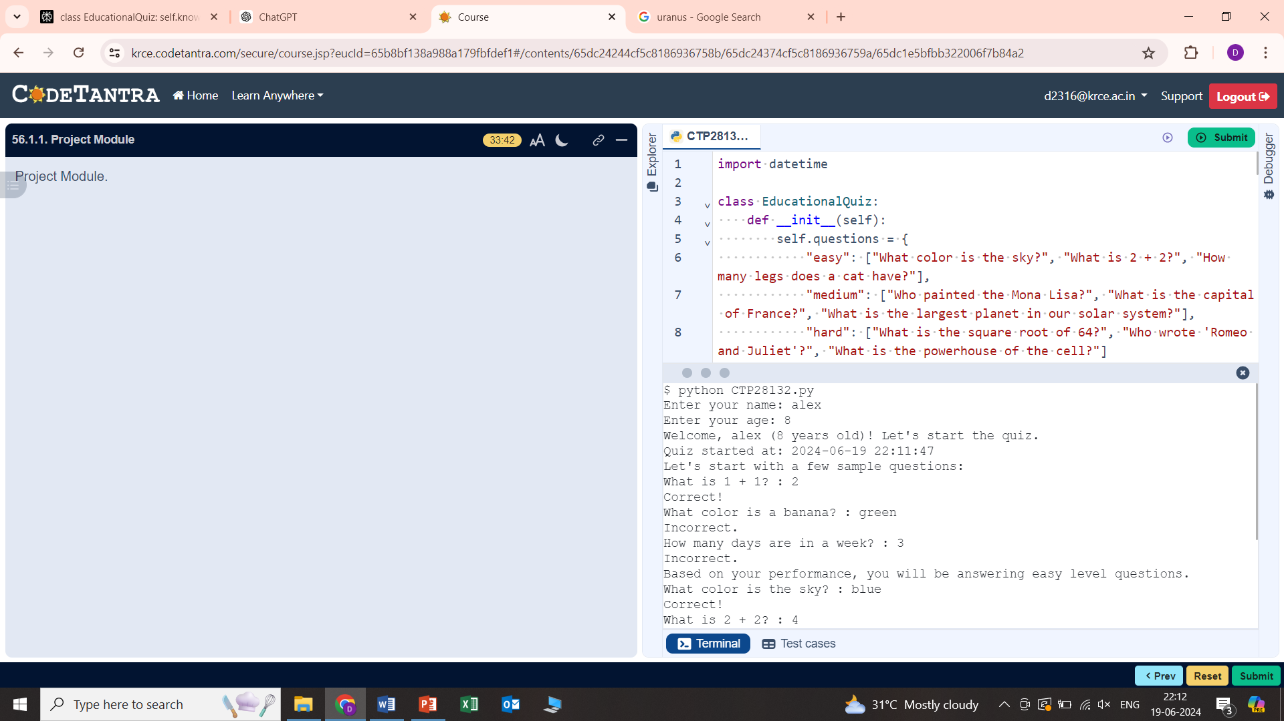
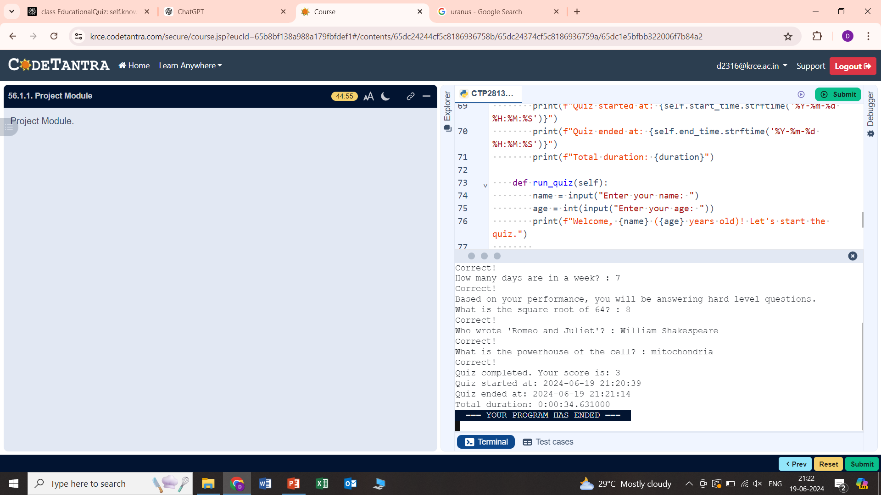
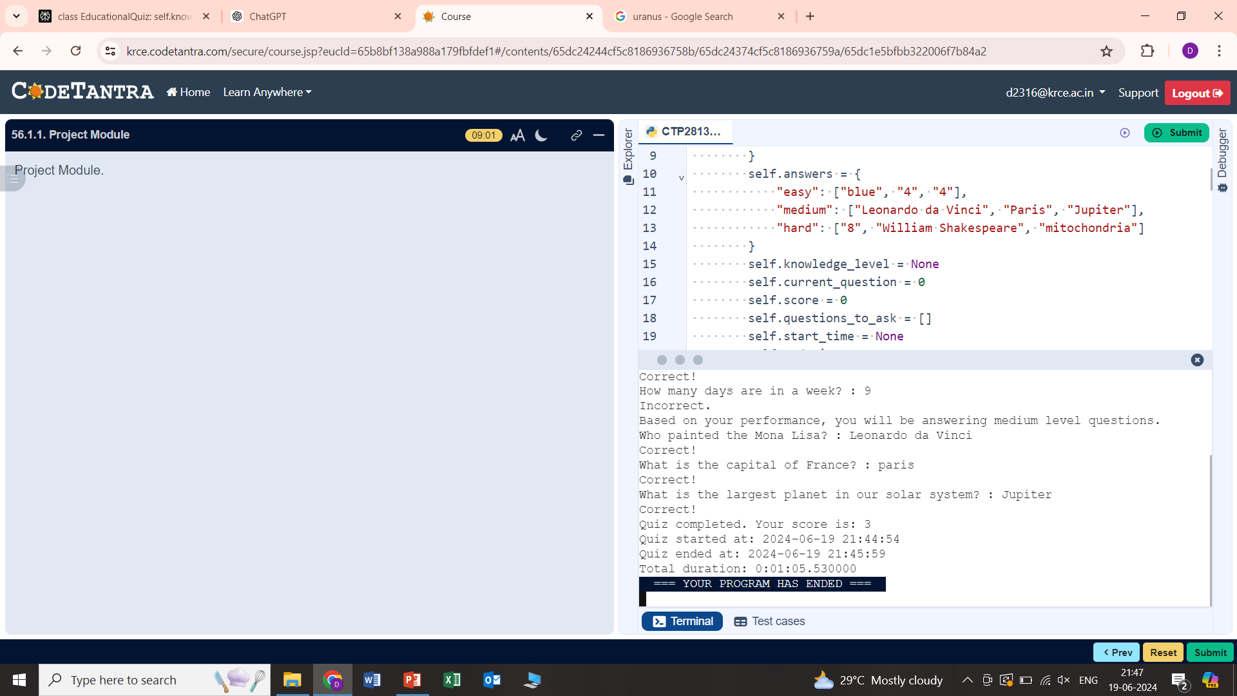
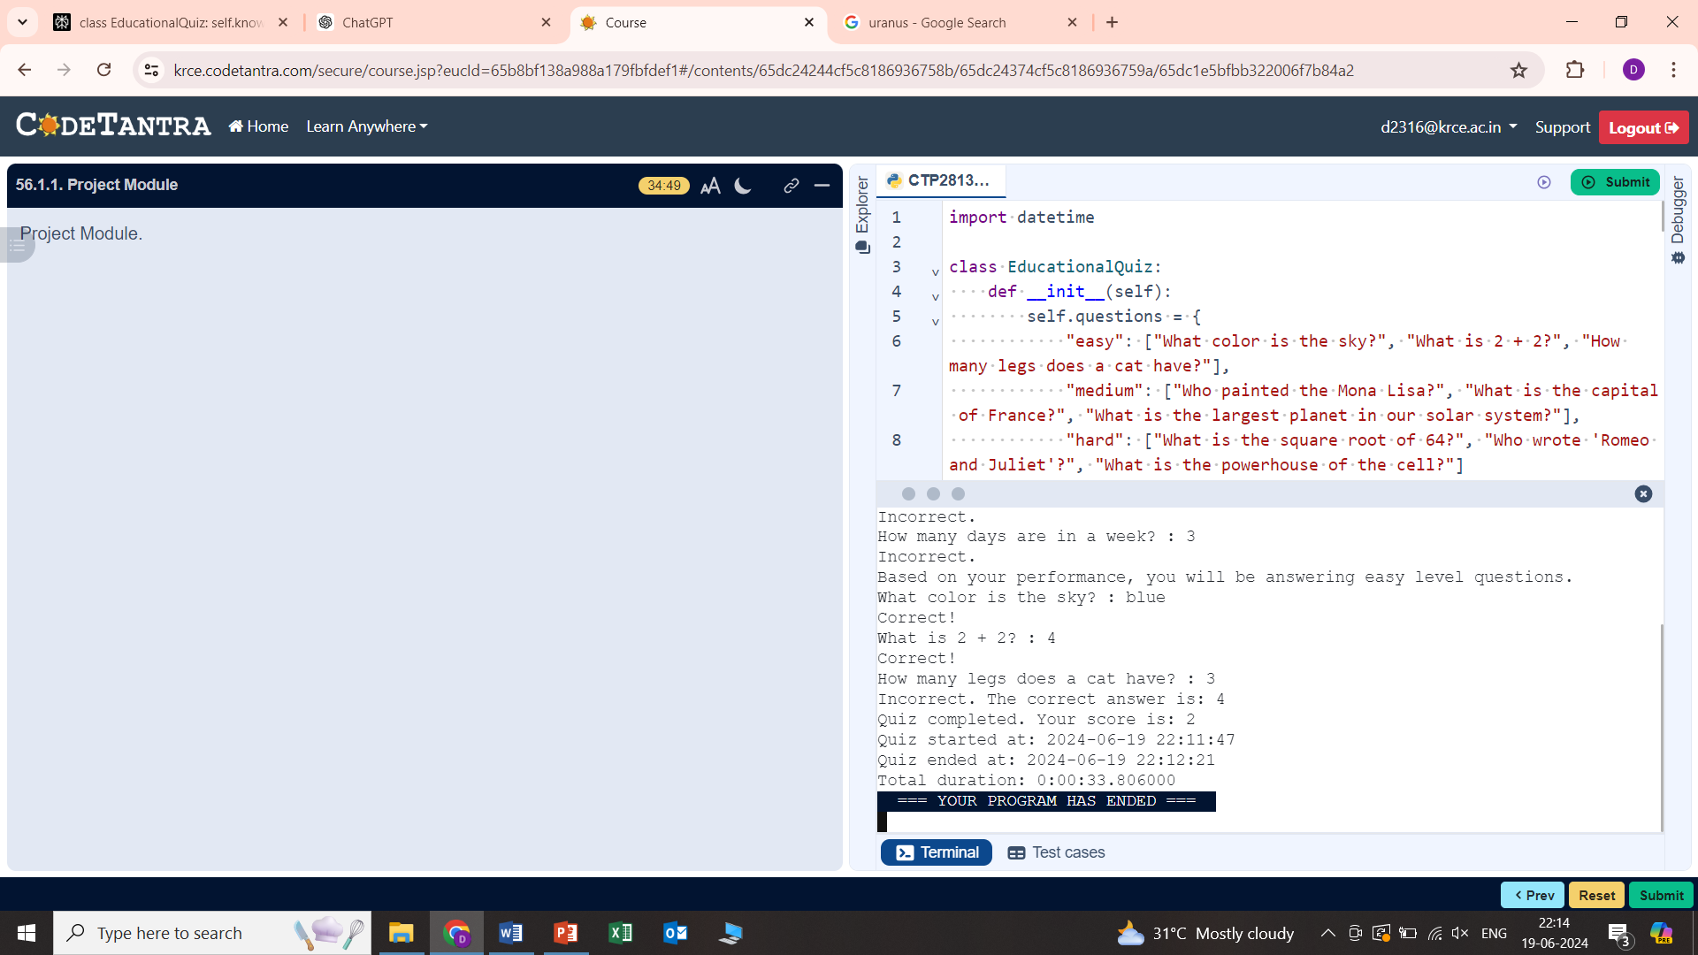
output

Slide 8
WORK FLOW
REGISTRATION
Special children or their guardians can easily register for the quiz through a user-friendly interface.
1
ASSESSMENT
The quiz begins with an initial assessment to determine the child's knowledge level and learning needs.
2
PERSONALIZED EXPERIENCE
The quiz adapts the content and difficulty based on the child's performance, ensuring a tailored learning journey.
3

Slide 9


PROS AND CONS
Engaging and interactive learning experience
Personalized to each child's needs and abilities
Promotes inclusivity and celebrates diversity
Fosters skill development and confidence building
Requires access to technology and devices
Initial setup and customization may be time consuming
Ongoing maintenance and updates are necessary
Potential for technical issues or connectivity problems

Slide 10



CONCLUSION
EMPOWERING
The educational quiz empowers special children by providing a engaging and personalized learning experience.
INCLUSIVE
The quiz promotes inclusivity and celebrates the unique strengths and talents of all learners.
REWARDING
The quiz's scoring and feedback mechanisms help build confidence and a sense of achievement.

Slide 11


